Slide 1
DATA ANALYSIS
GYM MEMBER EXERCISE
Project By: Nizam Jaafar
LinkedIn: mdnizamjaafar
Github: mdnizamjaafar

Slide 2
OVERVIEW
This is an analysis project on gym members’ fitness, health and performance patterns and trends. The original dataset did not include crucial information on BMI and fat classification, which are essential for extensive research on gym members' overall health. Therefore, an extra initiative was taken to pull out the information using trusted sources and integrate it with the original dataset. Now, we can delve deeper into their health and have also classified their heart rate usage during exercise based on their age and etc.
Sources Used:
Dataset: Kaggle
BMI Classification: National Center for Biotechnology Information
Fat Classification: Omron Healthcare
Exercise Heart Rate Classification: American Heart Association
Resting Heart Rate Classification: MedicineNet
Goals:
Provide insights into gym members' fitness, health and performance trends.
Analyze and report on correlation of each metrics.
Identify members who require attention for their overall health.
Offer insights into different workout type routines.
Provide proposal for fitness, health and performance improvement.

Slide 3
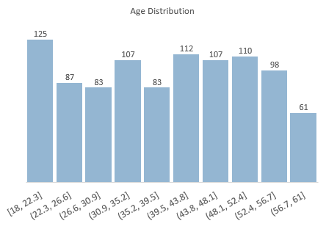
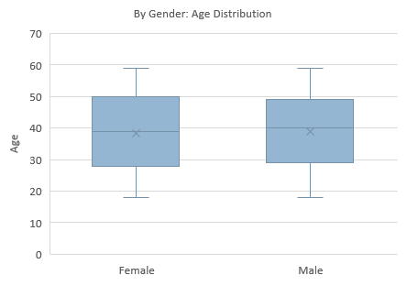

Slide 4
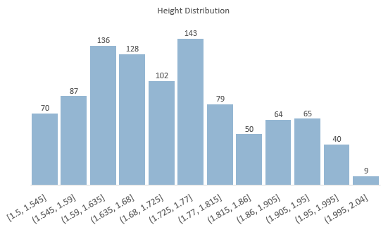
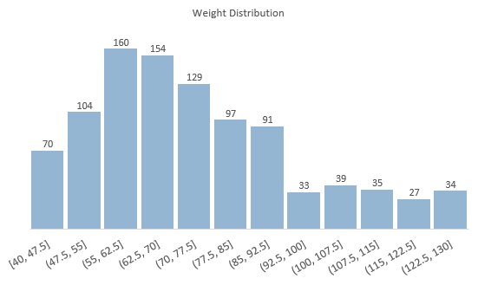

Slide 5
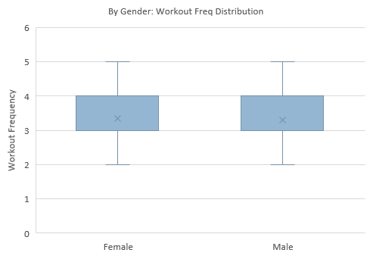
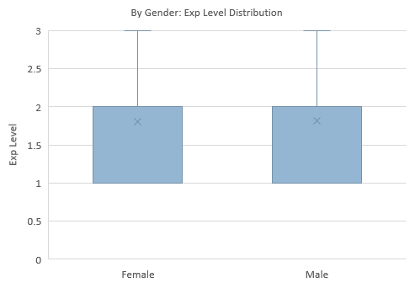

Slide 6
CORRELATION MATRICES
Variable | Age | Weight (KG) | Height (M) | BMI | Fat Percentage | Experience Level | Workout Frequency (Day / Week) | Session Duration (Hours) | Max BPM | Avg BPM | Resting BPM | Calories Burned
Age | 1
Weight (KG) | -0.036339635 | 1
Height (M) | -0.027837495 | 0.365321203 | 1
BMI | -0.01369137 | 0.85315769 | -0.15946875 | 1
Fat Percentage | 0.002370051 | -0.22551164 | -0.235520936 | -0.11925776 | 1
Experience Level | -0.018675927 | 0.003378528 | -0.010266611 | 0.016031073 | -0.654362613 | 1
Workout Frequency (Day / Week) | 0.008055163 | -0.011769328 | -0.011269883 | 0.001644974 | -0.537059548 | 0.837078709 | 1
Session Duration (Hours) | -0.019911904 | -0.013665561 | -0.010205897 | -0.006492647 | -0.581519771 | 0.764768119 | 0.644140366 | 1
Max BPM | -0.017072597 | 0.05706113 | -0.017659884 | 0.067105231 | -0.009055731 | 0.000544834 | -0.029099066 | 0.010050981 | 1
Avg BPM | 0.035969143 | 0.009717478 | -0.014776288 | 0.0216055 | -0.007301655 | -0.000888157 | -0.010680798 | 0.016014438 | -0.039751443 | 1
Resting BPM | 0.004353714 | -0.032138091 | -0.005089864 | -0.032542632 | -0.016834389 | 0.001757585 | -0.007966891 | -0.016648808 | 0.036647481 | 0.059635502 | 1
Calories Burned | -0.15467876 | 0.095443473 | 0.086348051 | 0.059760826 | -0.597615248 | 0.694129448 | 0.576150125 | 0.908140376 | 0.002090016 | 0.339658667 | 0.016517951 | 1
Water Intake (Liters) | 0.041528359 | 0.39427571 | 0.393532902 | 0.213696572 | -0.588682834 | 0.304103549 | 0.238562571 | 0.283410977 | 0.031620643 | -0.002910637 | 0.007725998 | 0.356930683

Slide 7
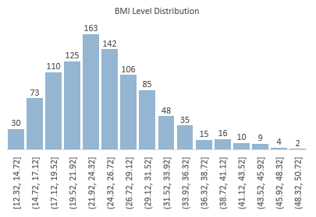
BMI Level Distribution
Skewed to the Right: Distribution mainly occurs around 12.32 to 36.32.
Proportion Analysis:
Severely Underweight: 8.63%
Underweight: 8.63%
Normal: 38.03%
Overweight: 24.97%
Obesity Class: 19.73%
(Source: https://www.ncbi.nlm.nih.gov/books/NBK541070/)
Insight
1. Focus on Obesity & Underweight Class:
Significant Proportion: 19.73% falls under obesity class while underweight class around 17.26%.
It's essential to understand that a higher or lower BMI doesn't necessarily equate to poor health.
Additional Metrics: Important to consider fat percentage and performance metrics for a comprehensive health assessment.
Regression Analysis
Statistically Significant: Strong relationship between BMI and Weight with a p-value under 0.5.
Variance Explained:
R Square: 72.79% variance in BMI explained by Weight.
Coefficient:
For every kilogram increase in Weight, BMI increases by approximately 0.268 units.
Regression Statistics
Multiple R | 0.85315769
R Square | 0.727878044
Adjusted R Square | 0.727597795
Standard Error | 3.476457142
Observations | 973
Independent Variable | Coefficients | Standard Error | t Stat | P-value | Lower 95% | Upper 95% | Lower 95.0% | Upper 95.0%
Intercept | 5.1220 | 0.4040 | 12.6782 | 0.0000 | 4.3292 | 5.9148 | 4.3292 | 5.9148
Weight (KG) | 0.2680 | 0.0053 | 50.9633 | 0.0000 | 0.2576 | 0.2783 | 0.2576 | 0.2783

Slide 8
Obesity and Underweight Class
Insight:
Analysis shows that for someone that categorize under class of Obesity or Underweight can still have better fat percentage than other BMI class.
Many members in Obesity Class 1 and Overweight class have range of fat percentage around 10% to 15%. This reject the perception of BMI level indicate someone health status.
Weight has a significant influence on BMI but weight can be impacted by bones and muscle density. (Source: https://healthfully.com/bmi-index-according-to-bone-structure-6466650.html?form=MG0AV3).
Additionally, we can see for class of Normal, we found that more than 50% of gym members have fat percentage than 20%. The same goes to Underweight and Overweight Class
Proposal:
To tailor and market a specialized fitness program for those with fat percentage than 20% for male members and above 30% for female members. (Source: https://www.omronhealthcare-ap.com/my/faqs/weight-management).
Periodic health assessment to monitor their fat percentage by quarterly or monthly to have a further analysis on their improvement based on data collected.

Slide 9
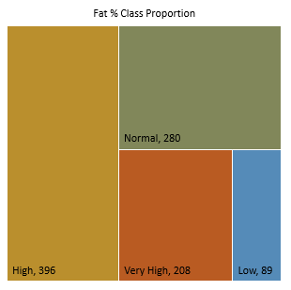
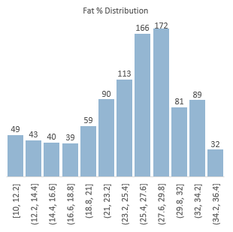
Independent Variables | Coefficients | P-value
Intercept | 36.81159415 | 4.7E-278
Experience Level | -4.54238299 | 8.37E-24
Workout Frequency (Day / Week) | 0.262727999 | 0.381473
Session Duration (Hours) | -3.570782462 | 1.72E-07
Insight
1. Experience Level
Coefficient: -4.542, indicating a strong negative relationship with Fat Percentage. Each increase in experience level decreases Fat Percentage by approximately 4.54 units.
P-value: Extremely significant (8.36796E-24).
2. Workout Frequency (Days/Week)
Coefficient: 0.263, showing a very small positive relationship with Fat Percentage, but it’s not statistically significant (P-value: 0.381).
3. Session Duration (Hours)
Coefficient: -3.571, showing a significant negative relationship with Fat Percentage. Each additional hour of session duration decreases Fat Percentage by approximately 3.57 units.
P-value: Highly significant (1.72249E-07).
Conclusion
Experience Level and Session Duration significantly impact Fat Percentage, with higher levels and longer sessions leading to lower fat percentages. Workout Frequency, however, does not show a significant relationship in this multiple regression context.
Proposal
To strategize a program to enhance gym members experience and session duration with consultation from expert trainer.
Market and campaign to emphasize on importance of exercise in improving fat percentage which directly asking for gym members and outsiders to exercise often; potentially increasing gym membership and revenue.

Slide 10
Independent Variables | Coefficients | P-value
Intercept | 45.99206 | 0
Calories Burned | -0.0102 | 2.11E-66
Water Intake (Liters) | -4.48651 | 5.99E-63
Calories Burned & Water Intake Insight
Members with low fat percentage tend to drink more water though the calories burned below 1000.
Normal class fat percentage, will have higher water intake when they burned their calories above 1000.
Insight
1. Water Intake and Fat Percentage
Significance: Water intake has a significant relationship with fat percentage, with a p-value indicating strong statistical significance. For each liter of water consumed, fat percentage decreases by approximately 4.49 units.
Variance Explained: Only 34.65% of the variation in fat percentage can be explained by water intake, suggesting other factors are also at play.
2. Calories Burned and Fat Percentage
Significance: Calories burned also show a significant relationship with fat percentage, with a p-value indicating strong statistical significance. Each calorie burned reduces fat percentage by approximately 0.0102 units.
Variance Explained: Only 35.71% of the variation in fat percentage can be explained by calories burned, indicating the influence of other variables on fat loss.
Proposal
Encourage and guide members to increase their calories burning with appropriate exercise or workout routine.
Plan a program that incorporate hydration strategies and effective workout with high calories burning to optimize fat loss.

Slide 11
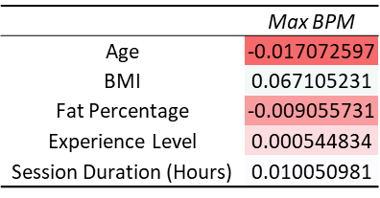
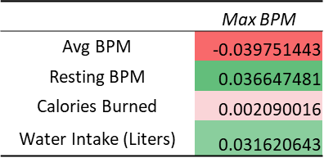
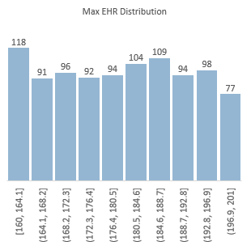
Insight
The distribution of Max EHR BPM is evenly distributed with no skew.
91.88% gym members reach high and critical EHR zones during their workout.
From the correlation matrices we can see that Max BPM almost have no correlation with all the demographic, behavioral, performance and fitness metrics.
Scientifically, max exercise heart rate (EHR) BPM factored also by medication, stress, food and also environmental.
To study more on gym members max EHR BPM, we should take extensive data collection on above factors.
But, if we delve into age factor and referring to research from American Heart Association, EHR zone is impacted by age of person. The older they are, the lower their max zone level. (Source: https://www.heart.org/en/healthy-living/fitness/fitness-basics/target-heart-rates).
Proposal
Conduct health assessment periodically for gym members to track their overall performance and fitness metric.
Educate gym member on importance of monitoring heart level; how to ensure they are not jeopardizing their health during workout.

Slide 12
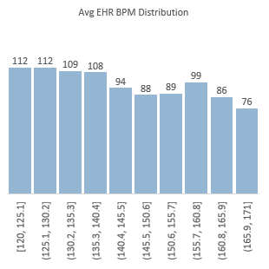
 | Coefficients | P-value
Intercept | 142.1281 | 0
Age | 0.04236 | 0.262329
Insight
The distribution of Avg EHR BPM is evenly distributed with no skew.
98.66% gym members reach normal and high EHR zones during their workout.
For balance of 11.44% or 13 members, we found that they are inside category of critical EHR zone.
Gym members who inside critical zone is within age of 55 – 60 years old with diversity of BMI class from severely underweight to obesity class 3.
Regression analysis being done and found that there are weak statistic relationship between age and Avg EHR BPM with P-Value of 0.262 and the variance of Avg EHR BPM that can be explained by age of member is too low at 0.13%.
Conclusion, to provide attention on these group of 13 members to ensure they are not pushing themselves to dangerous limit during workout to avoid severe health risk.
EHR zone is impacted by age of person. The older they are, the lower their max zone level. (Source: https://www.heart.org/en/healthy-living/fitness/fitness-basics/target-heart-rates).
Proposal
Conduct health assessment periodically for gym members to track their overall performance and fitness metric.
Educate gym member on importance of monitoring heart level; how to ensure they are not jeopardizing their health during workout.

Slide 13
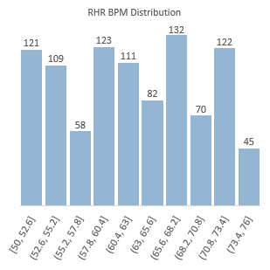
Independent Variable | Coefficients | P-value
Intercept | 62.55886 | 0
Workout Frequency | -0.25306 | 0.591126
Experience Level | 0.278882 | 0.631489
Insight
The distribution of RHR BPM is evenly distributed.
By RHR Zone, 72.15% of gym members are categorized within good and athlete zones.
Of the 103 members inside Athlete category, 75 of them are males and balance of 28 are females.
By fat class, we can see the diversity of the class for each RHR zone. Focus on Athlete zone, 29% of them are inside Very High fat class. This might due to various factors such as sports the are into, genetics and so on. Extensive research need to be done to find the accurate answer for each members. (Source: Elite Body Fat Percentages | BodyStack).
By age distribution, we can see that each age group included inside each RHR zone. Indicating that age is not a major factor that influence RHR BPM.
By correlation values, we found that none of the metrics in the dataset correlate with RHR BPM. A regression analysis also has been done with workout frequency and experience level as independent variable but the result shows that the significance statistic are 0.59 and 0.63 respectively which is a weak relationship.
Indeed, need to consider other factors that might affect RHR BPM such as, comprehensive fitness level, body temperature, emotions, medications, substance use and etc. (Source: Resting heart rate – definition, impacting factors & how to check it | healthdirect).
Bear in mind that RHR zone differ by age group and gender. (Source: https://www.medicinenet.com/what_is_a_good_resting_heart_rate_by_age/article.htm).
Lower RHR BPM doesn’t mean that they are in absolute best of fitness level as health problem also can cause RHR in lower zone. (Source: Your resting heart rate can reflect your current and future health - Harvard Health).
Proposal
Conduct health assessment periodically for gym members to track their overall performance and fitness metric.
Educate gym member on importance of monitoring heart level; how to ensure they are not jeopardizing their health during workout.

Slide 14
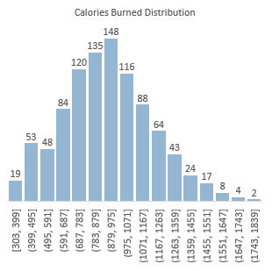
R Square: 0.8247
Insight
Distribution of calories burned for all gym members is slightly skewed to the right.
Correlation matrices for calories burned shows that all the metrics have value above 0.3 except for Max BPM at 0.002.
High Intensity Interval Training or HIIT emerge as the leaders of average calories burned per member despite having the lowest number of members that participate, count at 221.
The distribution varies evenly around hours 0.5 to 1.49, but the pattern diverse around 1.5 to 2 hours with some of them exceed 1600 calories burned.
We can conclude that each workout will burned more calories when they exceed 1 hour and 30 minutes. This is because of heart rate will keep increasing the longer we did an exercise and the continual pumping of blood by the heart demands energy, as does the continual ventilation (movement of air into and out) of the lungs. (Source: Calorie Burning).
With the result of multiple variable of regression analysis which we combine metrics of fitness, behavioural and performance, the result shows that session duration (hour) has the most impact by coefficient of 701 units increased per hour. Follow by water intake at 50.86 calories per litre of water intake and 6.19 calories increased per 1 avg EHR BPM.
Experience level, workout frequency and max BPM has a weak relationship comparing to other variables which is the result not tally with their correlation values at 0.69 for experience level and 0.58 for workout frequency.
Their impact is less significant in the regression model due to the presence of more influential variables and potential multicollinearity.
Proposal
Enhanced training programs by emphasizing longer workout (1.5 hours and above) to maximise calories burning.
To promote program of HIIT to other gym members with data showcasing that even with less participant, it is more effective to burn calories. But, this doesn’t mean we can reject the effectiveness of other workouts.
Regression Statistics
Multiple R | 0.970504849
R Square | 0.941879662
Adjusted R Square | 0.941518666
Standard Error | 65.93266412
Observations | 973
Correlation Matrices | Calories Burned
Calories Burned | 1
Experience Level | 0.694129448
Workout Frequency (Day / Week) | 0.576150125
Session Duration (Hours) | 0.908140376
Max BPM | 0.002090016
Avg BPM | 0.339658667
Water Intake (Liters) | 0.356930683
Independent Variable | Coefficients | P-value
Intercept | -994.9282167 | 5.37E-98
Experience Level | -1.846706019 | 0.767857
Workout Frequency (Day / Week) | -3.287144295 | 0.438699
Session Duration (Hours) | 701.0817453 | 0.0000
Max BPM | 0.054842053 | 0.765744
Avg BPM | 6.192662704 | 8.2E-220
Water Intake (Liters) | 50.8609612 | 4.04E-39

Slide 15
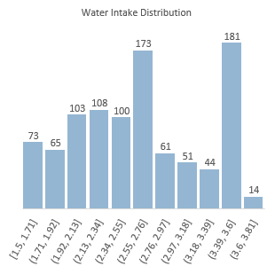
Independent Variable | Coefficients | P-value
Intercept | 5.751882 | 1.5E-48
Fat Percentage | -0.055 | 2.96E-52
Experience Level | -0.0597 | 0.196119
Workout Frequency (Day / Week) | -0.01058 | 0.723108
Session Duration (Hours) | -1.38028 | 6.18E-16
Max BPM | 0.001082 | 0.403893
Avg BPM | -0.01238 | 1.02E-12
Resting BPM | -0.00106 | 0.604358
Calories Burned | 0.001963 | 3.15E-18

